Slide 1

Visual Basic.NET More Windows Control

Slide 2
ROAD MAP
Introduction
Common Dialog Controls
RichTextbox Controls
RTF Language

Slide 3
INTRODUCTION
a set of controls for displaying common dialogs
such as Open or Color
common dialog controls are an essential part of a Windows application
they enable you to design user interfaces with the look and feel of a Windows application
Explore the RichTextBox control

Slide 4
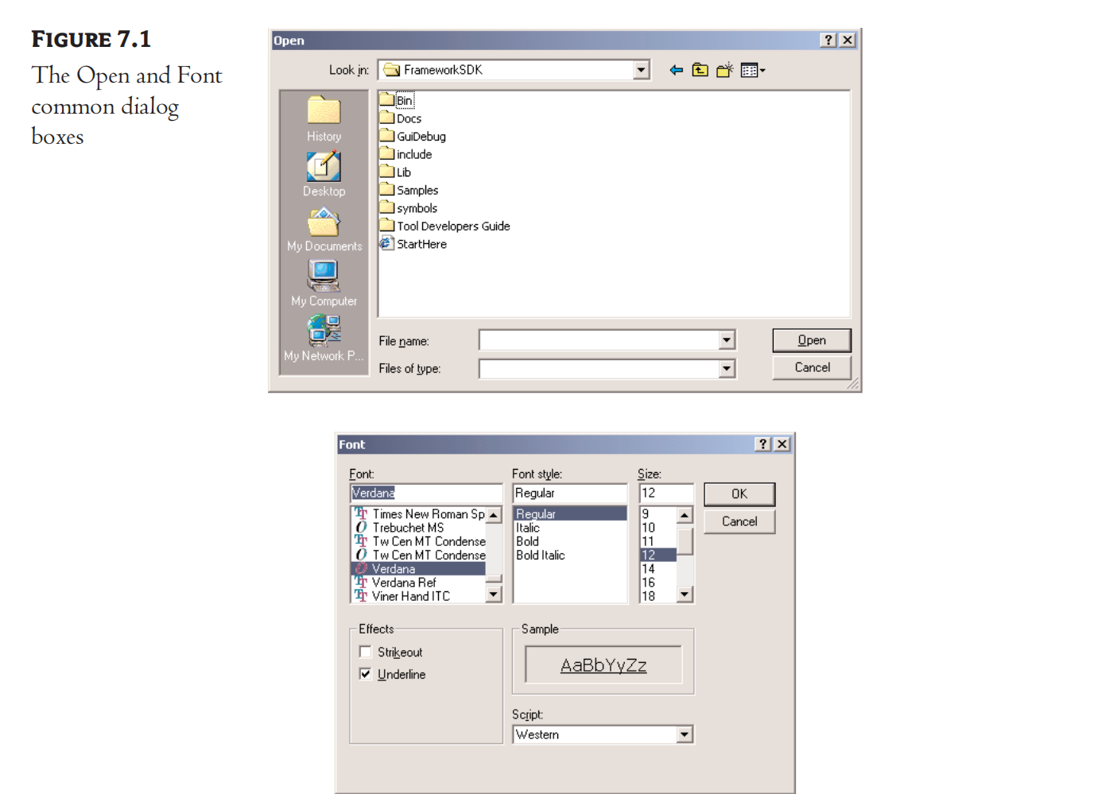
The Common Dialog Controls
A rather tedious, but quite common, task in nearly every application is to prompt the user for filenames, font names and sizes, or colors to be used by the application

Slide 5
The Common Dialog Controls
Invisible at runtime
Not placed on your forms
OpenFileDialog
Lets users select a file to open.
SaveFileDialog
Lets users select or specify a filename in which the current document will be saved
ColorDialog
Lets users select a color from a list of predefined colors, or specify custom color
FontDialog
Lets users select a typeface and style to be applied to the current text selection
PrintDialog
Lets users select and set up a printer

Slide 6
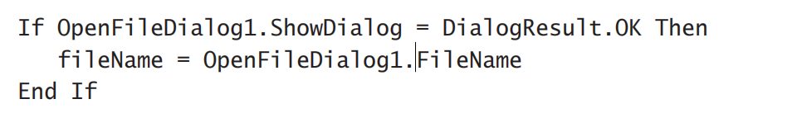
Using Common Dialog Controls
Call the control’s ShowDialog method

Slide 7
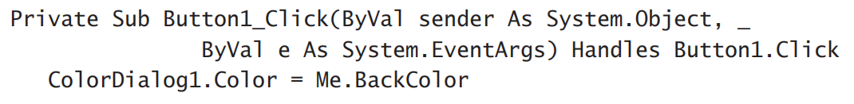
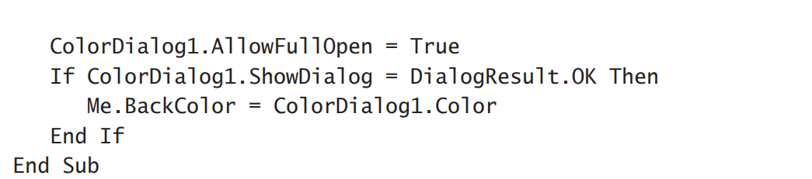
The Color Dialog Box
One of the simplest dialog boxes
Has a single property, Color
which returns the color selected by the user or sets the initially selected color when the user opens the dialog box

Slide 8
Properties
AllowFullOpen
Set True
users to be able to open up the dialog box and define their own custom colors
AnyColor
A Boolean value
whether the dialog box displays all available colors in the set of basic colors
Color
a Color value
Set to any valid color

Slide 9
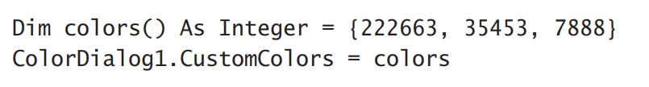
Properties
CustomColors
Indicate the set of custom colors that will be shown in the common dialog
Display 16 additional custom colors
SolidColorOnly
Indicates whether the dialog box will restrict users to selecting solid colors only
Only 256 colors

Slide 10
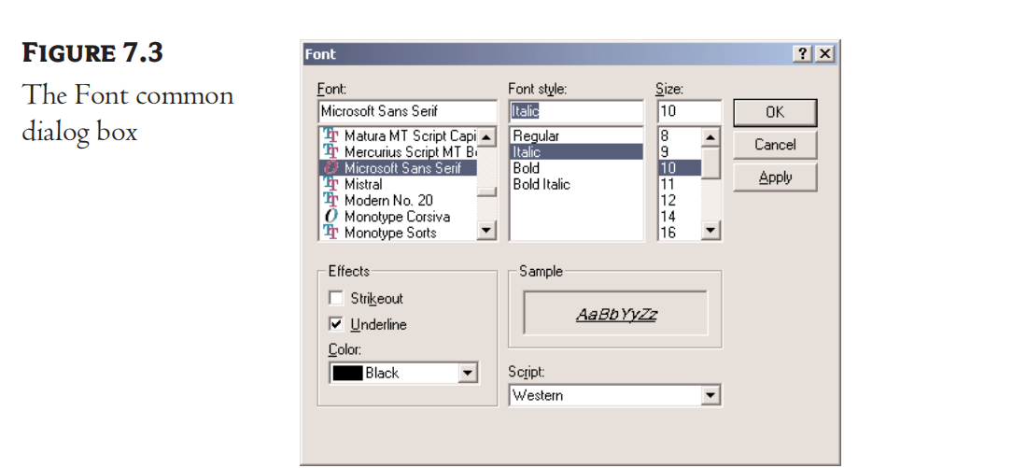
The Font Dialog Box
Let the user review and select a font and its size and style

Slide 11
The Font Dialog Box’s Properties
AllowScriptChange
a Boolean value
whether the Script combo box will be displayed on the Font common dialog
AllowSimulations
a Boolean value
whether the dialog box allows the display and selection of simulated fonts
AllowVectorFonts
a Boolean value
whether the dialog box allows the display and selection of vector fonts
AllowVerticalFonts
a Boolean value
whether the dialog box allows the display and selection of both vertical and horizontal fonts
Default = False – horizontal fonts

Slide 12
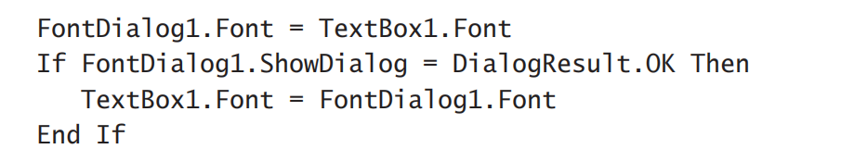
The Font Dialog Box’s Properties
Color
Set or return the selected font color.
FixedPitchOnly
a Boolean value
whether the dialog box allows only the selection of fixed-pitch fonts
Default = false – all fonts displayed on the common dialog
Font
a Font object

Slide 13
The Font Dialog Box’s Properties
FontMustExist
a Boolean value
whether the dialog box forces the selection of an existing font
Default = True
MaxSize, MinSize
integers that determine the minimum and maximum point size the user can select
ScriptsOnly
whether the dialog box allows selection of fonts for Symbol character sets
Default = True
ShowApply
a Boolean value
whether the dialog box provides an Apply button
Default = False

Slide 14
The Font Dialog Box’s Properties
ShowColor
a Boolean value
whether the dialog box allows the user to select a color for the font
ShowEffects
a Boolean value
whether the dialog box contains controls to allow the user to specify special text effects
strikethrough and underline

Slide 15
The Open and Save As Dialog Boxes
Two most widely used common dialog boxes
Implemented by the OpenFileDialog and SaveFileDialog controls
Most of the their properties are common

Slide 16
Properties
AddExtension
a Boolean value
whether the dialog box automatically adds an extension to a filename, if the user omits it
CheckFileExists
a Boolean value
whether the dialog box displays a warning if the user enters the name of a file that does not exist
CheckPathExists
a Boolean value
whether the dialog box displays a warning if the user specifies a path that does not exist, as part of the user-supplied filename

Slide 17
Properties
DefaultExtension
Set the default extension of the dialog box
TXT or DOC
DereferenceLinks
whether the dialog box returns the location of the file referenced by the shortcut or the location of the shortcut itself
C:\WINDOWS\SYSTEM32\lnkstub.exe
FileName
path of the file selected by the user on the control
The user can click OK/Cancel to select this file

Slide 18
Properties
Filter
specify the type(s) of files displayed on the dialog box
“Text files|*.txt”
multiple extensions
FilterIndex
specify more than one filter for the Open dialog box, the filter specified first in the Filter property becomes the default
InitialDirectory
set the initial directory (folder) in which files are displayed the first time the Open and Save dialog boxes are opened

Slide 19
Properties
RestoreDirectory
a Boolean value
whether the dialog box restores the current directory before closing
Default = False
ValidateNames
a Boolean value
whether the dialog box accepts only valid Win32 filenames
Default = True

Slide 20
Properties
FileNames
a collection
iterate through the filenames with an enumerator
MultiSelect
a Boolean value
whether the user can select multiple files on the dialog box
Default = False
ReadOnlyChecked
a Boolean value
whether the Read-Only check box is initially selected when the dialog box first pops up
ShowReadOnly
a Boolean value
whether the Read-Only check box is available

Slide 21
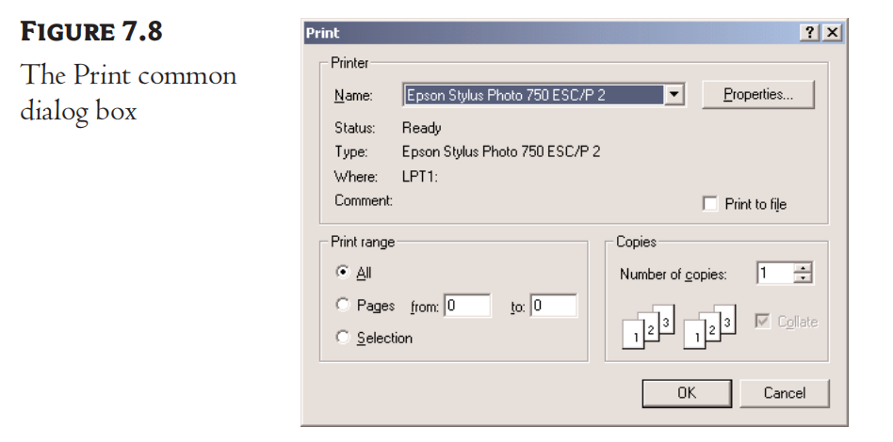
The Print Diaog Box
enables users to select a printer
set certain properties of the printout
number of copies and pages to be printed
set up a specific printer

Slide 22
The Print Dialog Box
AllowPrintToFile
a Boolean value
whether the user will be given the option to print to a file
AllowSelection
a Boolean value
whether the user is allowed to print the current selection of the document
AllowSomePages
a Boolean value
whether the Pages option on the dialog will be enabled

Slide 23
The RichTextBox Control
The core of a full-blown word processor
Provide all the functionality of a TextBox control
Give you the capability to mix different fonts, sizes, and attributes
Gives you precise control over the margins of the text
No need to supply the formatting codes
Provide simple properties that turn the selected text into bold, change the alignment of the current paragraph

Slide 24
RTF Property
RTF → Rich Text Format
a standard for storing formatting information along with the text
The text displayed on the control
Return the text along with any formatting information
Specify the text’s formatting, including paragraph indentation, font, and font size or style

Slide 25
The RTF Language
A basic knowledge of the RTF format
Simple Commands
ASCII strings
Similar to HTML

Slide 26
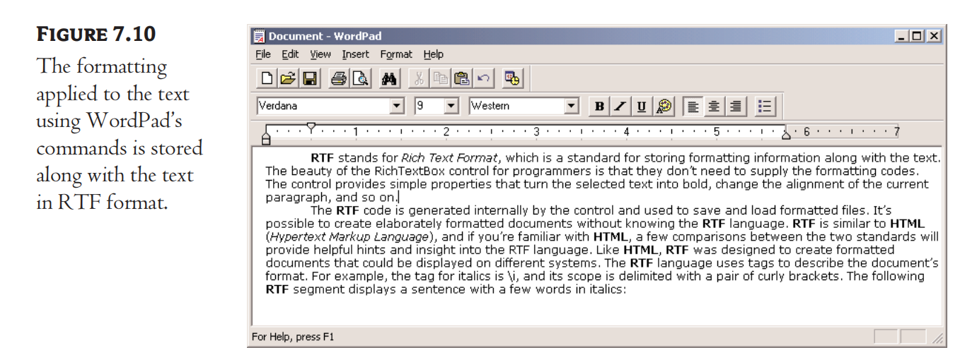
The RTF Language
Open the WordPad application
choose Start ➢ Programs ➢ Accessories ➢ WordPad
enter a few lines of text
File ➢ Save As
Document.rtf

Slide 27
The RTF Language
All formatting tags are prefixed with the backslash (\) symbol
Paragraphs are marked with the \par tag
The entire document is enclosed in a pair of curly brackets
The \li and \ri tags followed by a numeric value specify the amount of the left and right indentation

Slide 28
The RTF Language
RTF vs HTML

Slide 29
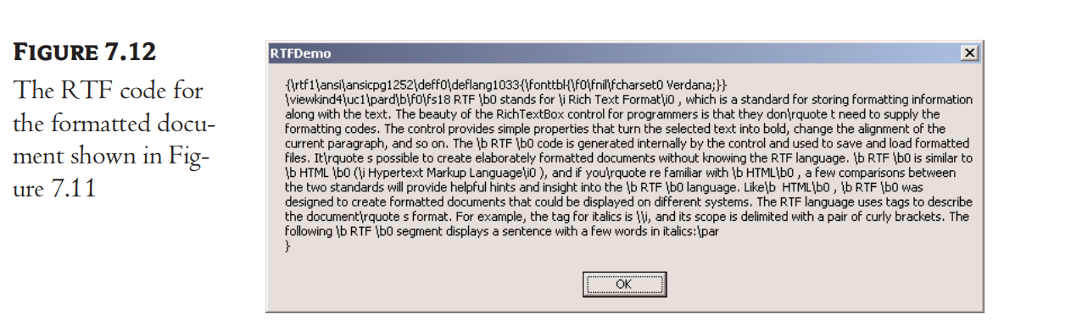
The RTF Code
Simply manipulating a few properties

Slide 30
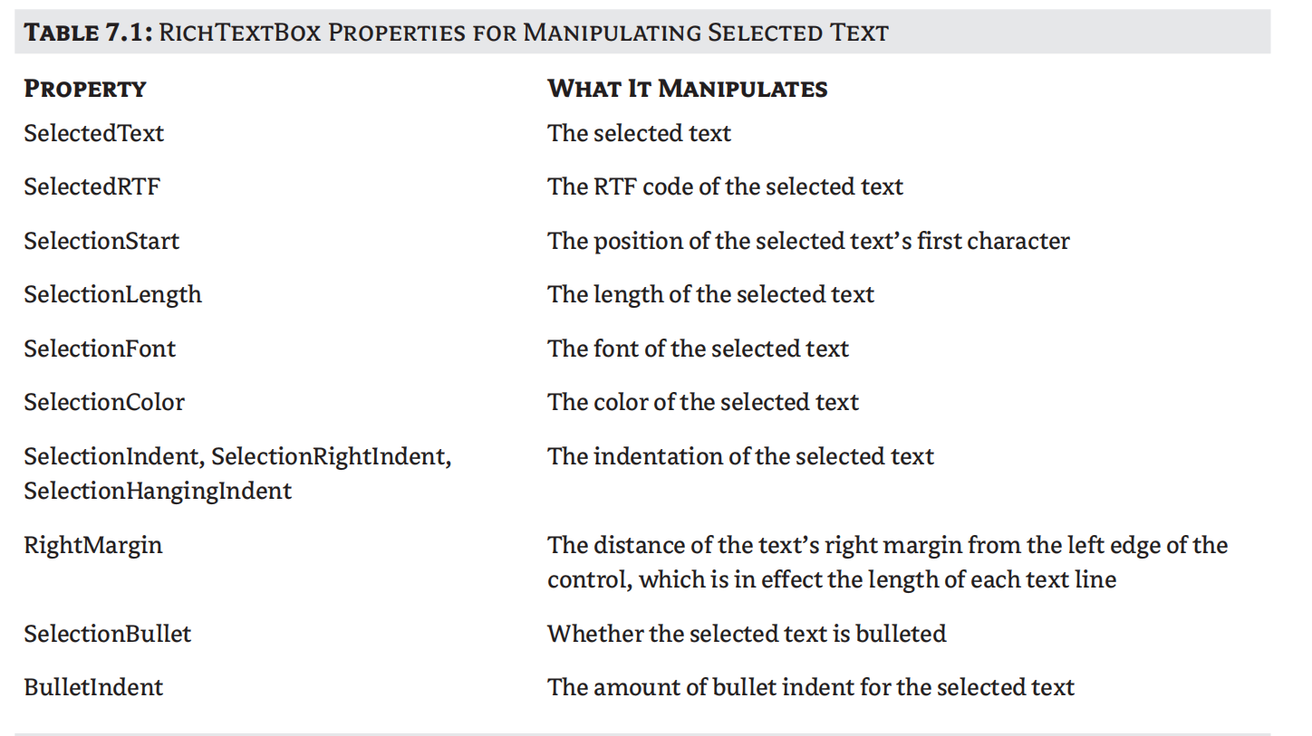
The RichTextBox’s Properties

Slide 31
Methods
SaveFile saves the contents of the control to a disk file.
LoadFile loads the control from a disk file

Slide 32
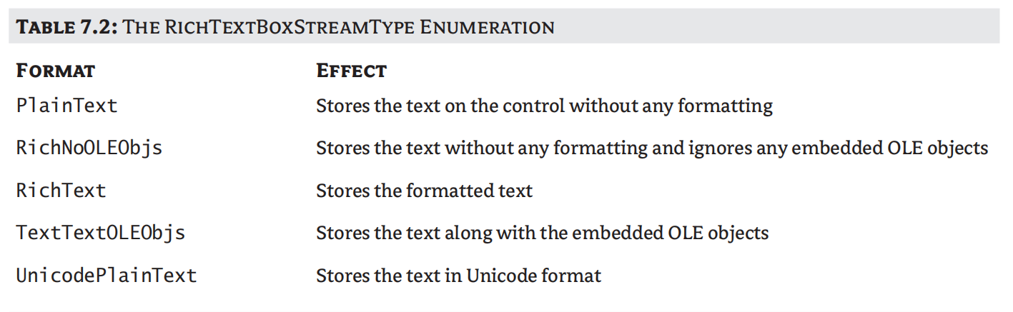
SaveFile
Syntax
path is the path of the file in which the current document will be saved
the SaveFile method saves the document in RTF format and uses the RTF extension

Slide 33

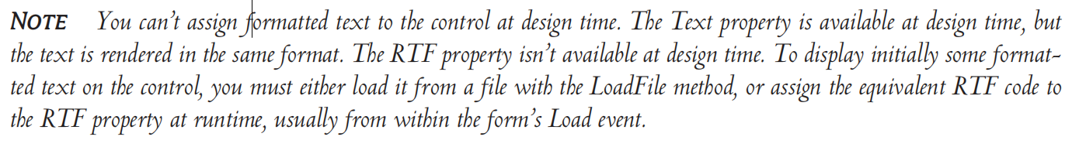
LoadFile
Syntax
filetype argument is optional and can have one of the values of the RichTextBoxStreamType enumeration

Slide 34

Select, SelectAll
Select Method
selects a section of the text on the control
accepts two arguments
SelectAll Method
accepts no arguments and selects all the text on the control

Slide 35
Exercise
(1) What are four options for each image file type?
(2) What are the meaning of the SelectionStart in the RichTextBox’s properties?

